Slide 1

BRACT’S, Vishwakarma Institute of Information Technology, Pune-48
(An Autonomous Institute affiliated to Savitribai Phule Pune University)
(NBA and NAAC accredited, ISO 9001:2015 certified)
Path Finding Algorithm
Subject: Advanced Data Structures
Name | Roll No. | PRN | E-mail
Aditya Dhanraj Kalbhor | 221005 | 22110053 | aditya.22110053@viit.ac.in
Sanwara Chandak | 221014 | 22110035 | sanwara.22110035@viit.ac.in
Prasad Chate | 221015 | 22110212 | prasad.22110212@viit.ac.in
Atharva Chaudhari | 221016 | 22110675 | atharva.22110675@viit.ac.in
Om Deore | 221022 | 22110318 | om.22110318@viit.ac.in
Guidence: Mrs. Snehal Rathi

Slide 2
Contents
What is pathfinding algorithm?
Depth First Search
Breadth First Search
Code explanation
Few more Application

Slide 3
What is path finding algorithm?
A pathfinding algorithm is a technique used to find the shortest or optimal path between two points in a graph or a network. In other words, it is a process of finding a path from a starting point to a goal or destination point, navigating through various obstacles or barriers that may exist in the path.
Pathfinding algorithms are commonly used in various fields, including computer science, transportation, robotics, and video games. For instance, in video games, pathfinding algorithms are used to guide the movement of characters or NPCs (non-playable characters) through a game world.
There are various pathfinding algorithms available, each with its own strengths and weaknesses. Some popular pathfinding algorithms include Dijkstra's algorithm, A* algorithm, breadth-first search, and depth-first search.

Slide 4
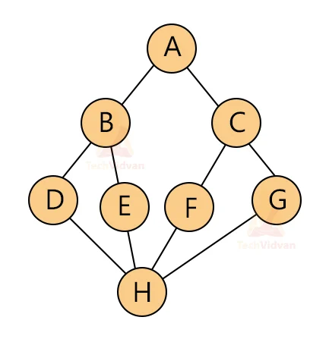
Depth First Search
Depth-first search (DFS) is an algorithm for traversing or searching tree or graph data structures.
The algorithm starts at the root node (selecting some arbitrary node as the root node in the case of a graph) and explores as far as possible along each branch before backtracking.
Extra memory, usually a stack, is needed to keep track of the nodes discovered so far along a specified branch which helps in backtracking of the graph.
Time Complexity: O(V+E)

Slide 5
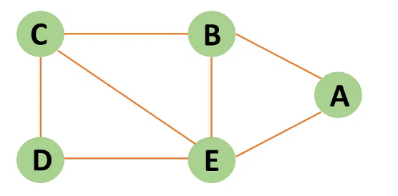
Breadth First Search
Breadth-first search is a graph traversal algorithm that starts traversing the graph from the root node and explores all the neighboring nodes.
Then, it selects the nearest node and explores all the unexplored nodes. While using BFS for traversal, any node in the graph can be considered as the root node.
Time complexity: O(V+E); Vis vertices & E is edges
Lets understand it with example:

Slide 6
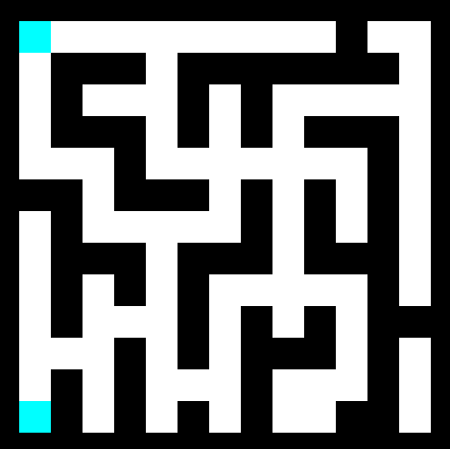
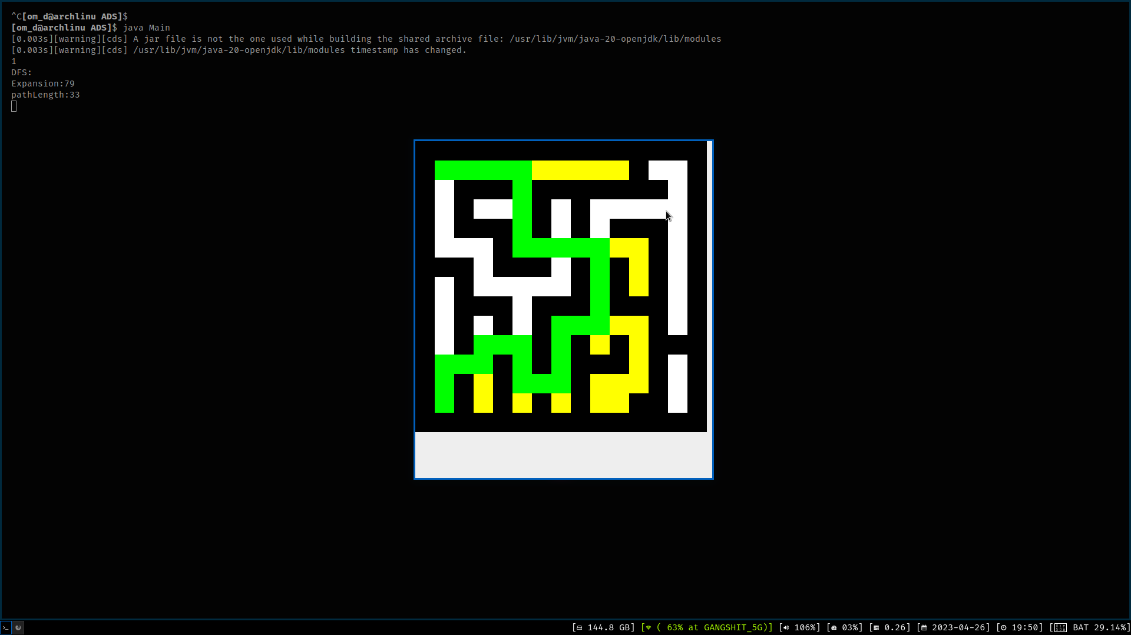
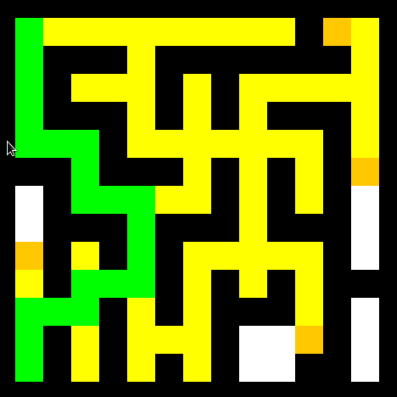
Code Execution
Before Execution
Depth First Search
Breadth First Search
For Code visit github repo: https://github.com/om101deore/ADS-project

Slide 7
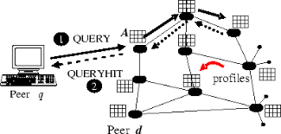

Application
BFS:
Peer to Peer Networks
GPS Navigation systems
In Garbage collection

Slide 8
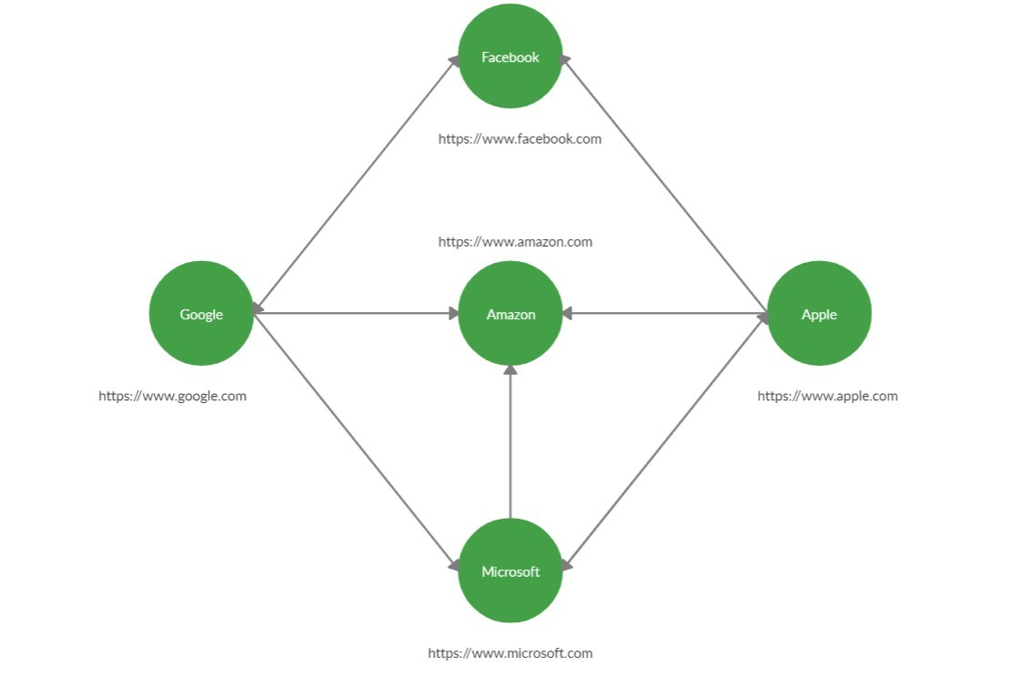
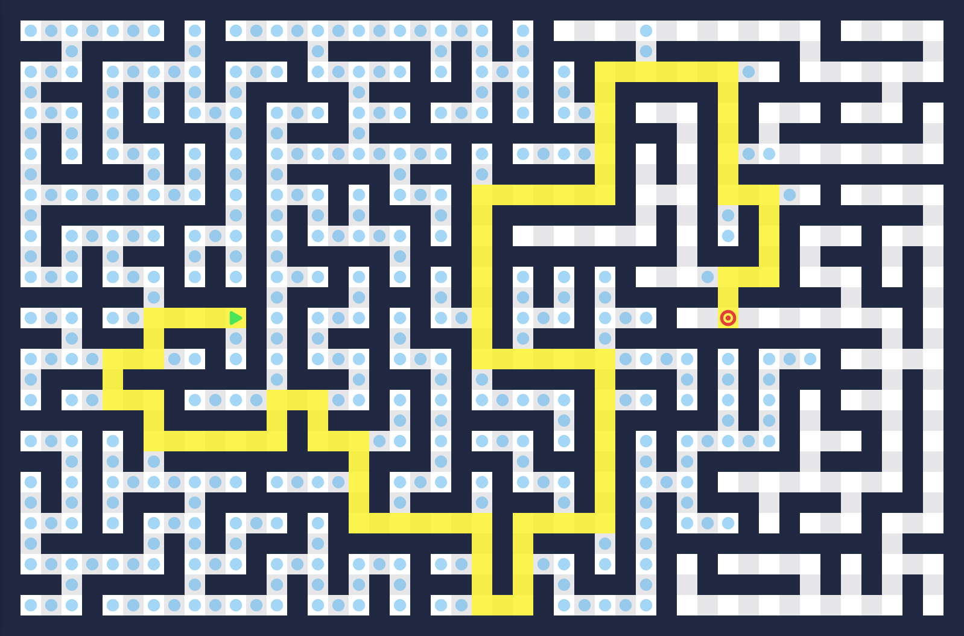
Application
DFS:
Solving puzzles with only one solution
Web crawlers
Maze generation

Slide 9
Thank You

